Slide 1
Bayesian Inference
Module 4, Lesson 3

Slide 2
Frequency Properties
Shahrzad Jamshidi, PhD

Slide 3
Last Time
Large-Sample Theory
The posterior tends to a normal distribution (asymptotic normality)
Counterexamples

Slide 4
Objectives
Evaluate Bayesian inferences from a frequentist perspective.
Understand how Bayesian methods relate to other statistical approaches.

Slide 5
Frequency Evaluations of Bayesian Inference
Frequentist (non-Bayesian) statistics can provide a useful approach for evaluating properties of Bayesian inference
From the perspective of repeated sampling.
Asymptotic normality is based on the idea of repeated sampling.
The same is true for the notion of posterior convergence.

Slide 6
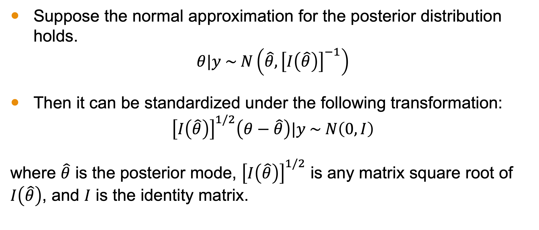
Large-Sample Correspondence
Suppose the normal approximation for the posterior distribution holds.
$$θ|y \sim N\left(\hat{θ},{\left[I\left(\hat{θ}\right)\right]}^{−1}\right)$$
Then it can be standardized under the following transformation:
$${\left[I\left(\hat{θ}\right)\right]}^{1/2}\left(θ−\hat{θ}\right)|y \sim N\left(0,I\right)$$
where $\hat{θ}$ is the posterior mode, ${\left[I\left(\hat{θ}\right)\right]}^{1/2}$ is any matrix square root of $I\left(\hat{θ}\right)$, and $I$ is the identity matrix.

Slide 7
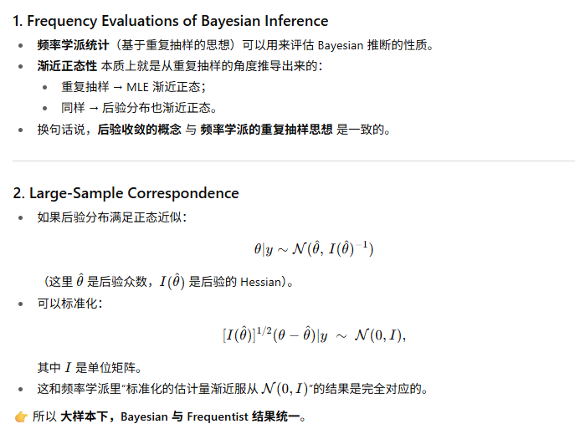
Notes:
Demonstrate the transformation
We showed in lesson 1 of module 4 that ….

Slide 8
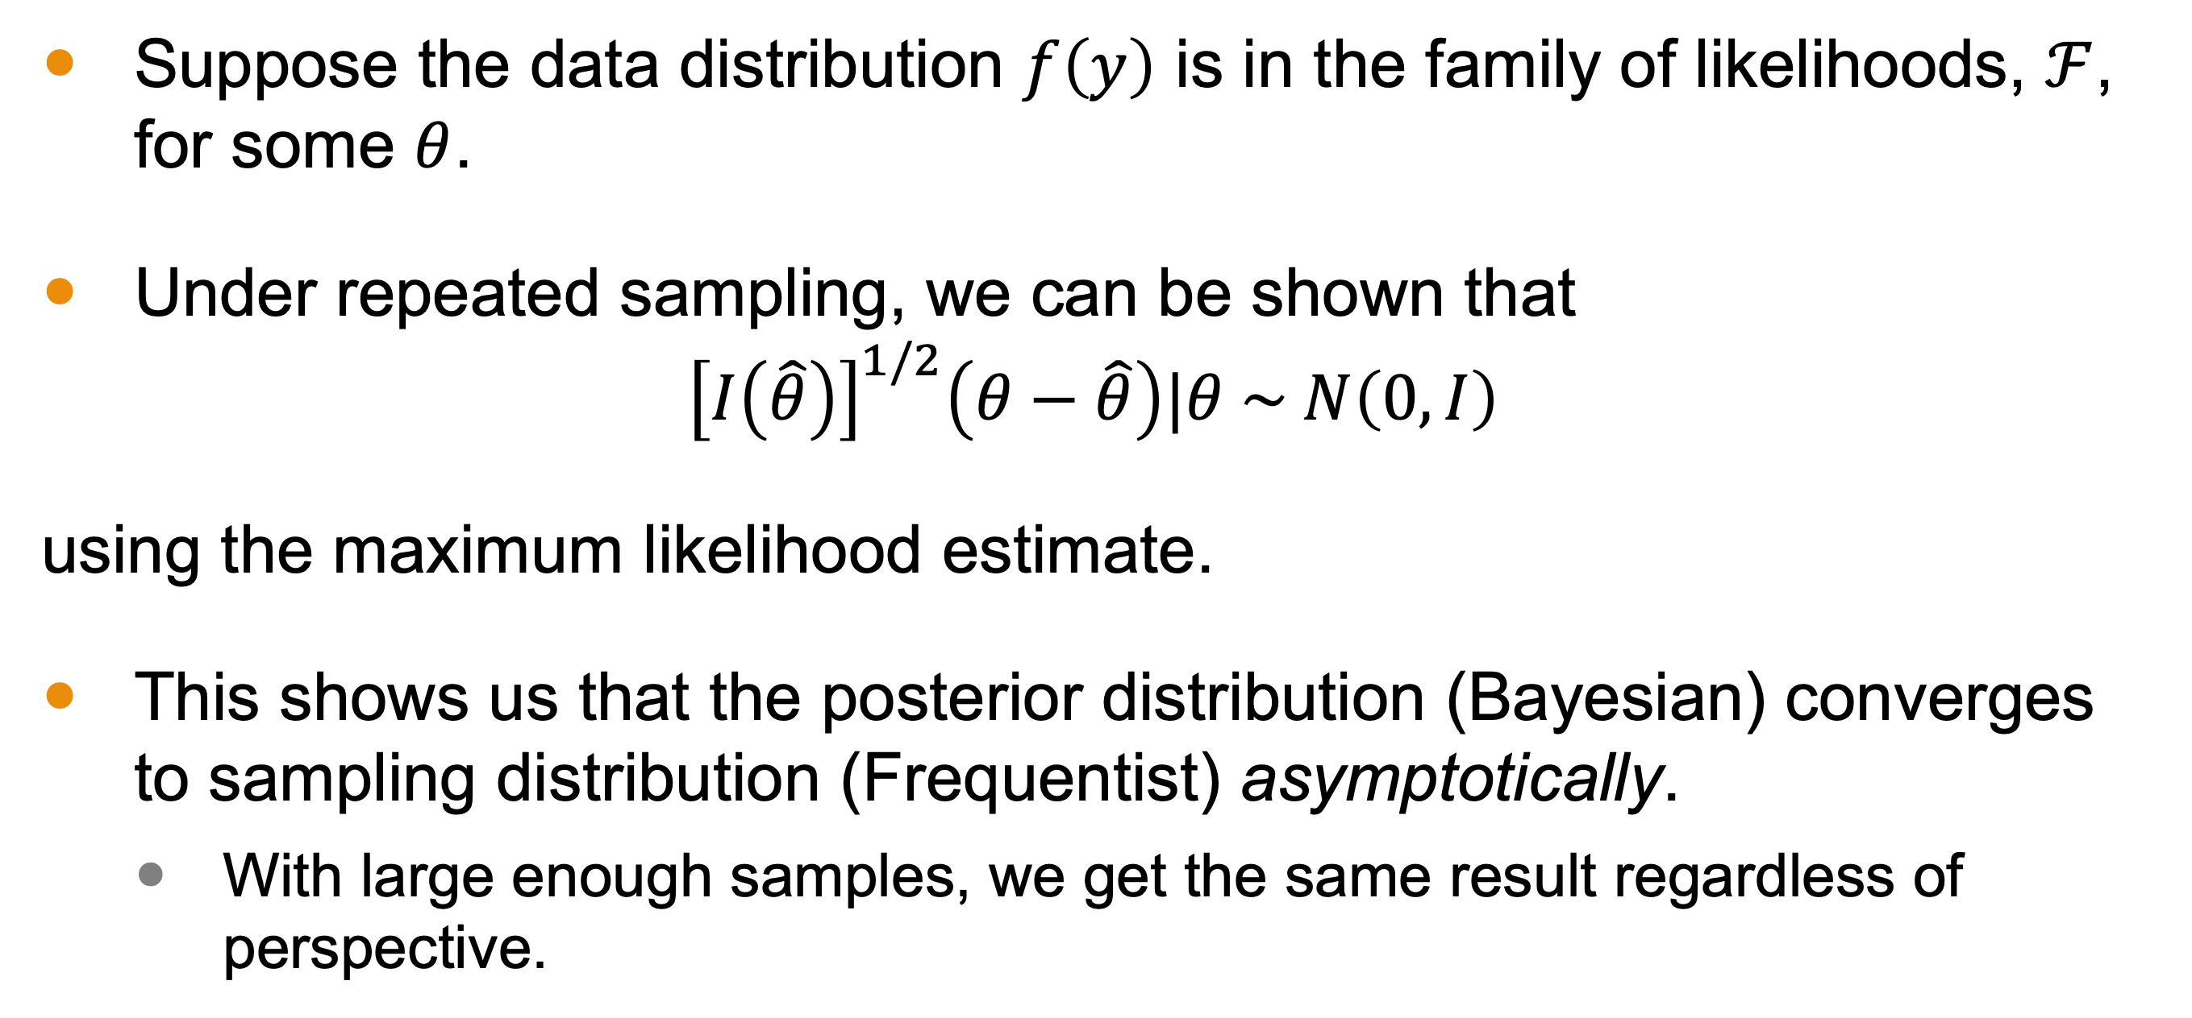
Equivalent Frequentist Result
Suppose the data distribution $f\left(y\right)$ is in the family of likelihoods, $ℱ$, for some $θ$.
Under repeated sampling, we can be shown that
$${\left[I\left(\hat{θ}\right)\right]}^{1/2}\left(θ−\hat{θ}\right)|θ \sim N\left(0,I\right)$$
using the maximum likelihood estimate.
This shows us that the posterior distribution (Bayesian) converges to sampling distribution (Frequentist) asymptotically.
With large enough samples, we get the same result regardless of perspective.

Slide 9
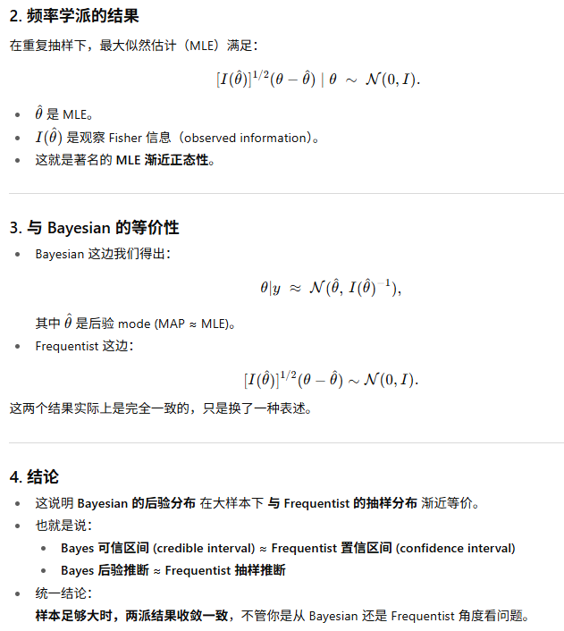
Equivalent Frequentist Result

Slide 10

More Examples in Reading
More examples in the reading
Topics covered:
Point estimates
Consistency
Efficiency
Confidence

Slide 11
Bayesian Interpretations of Other Methods
With large samples, Bayesian methods come to the same conclusions as the frequentist approach
With small samples, frequentist methods can be transformed to Bayesian methods with the right choice of prior.
Hypothesis testing, however, can produce different results
Other examples exist (see reading).
Here, we will discuss only hypothesis testing.

Slide 12
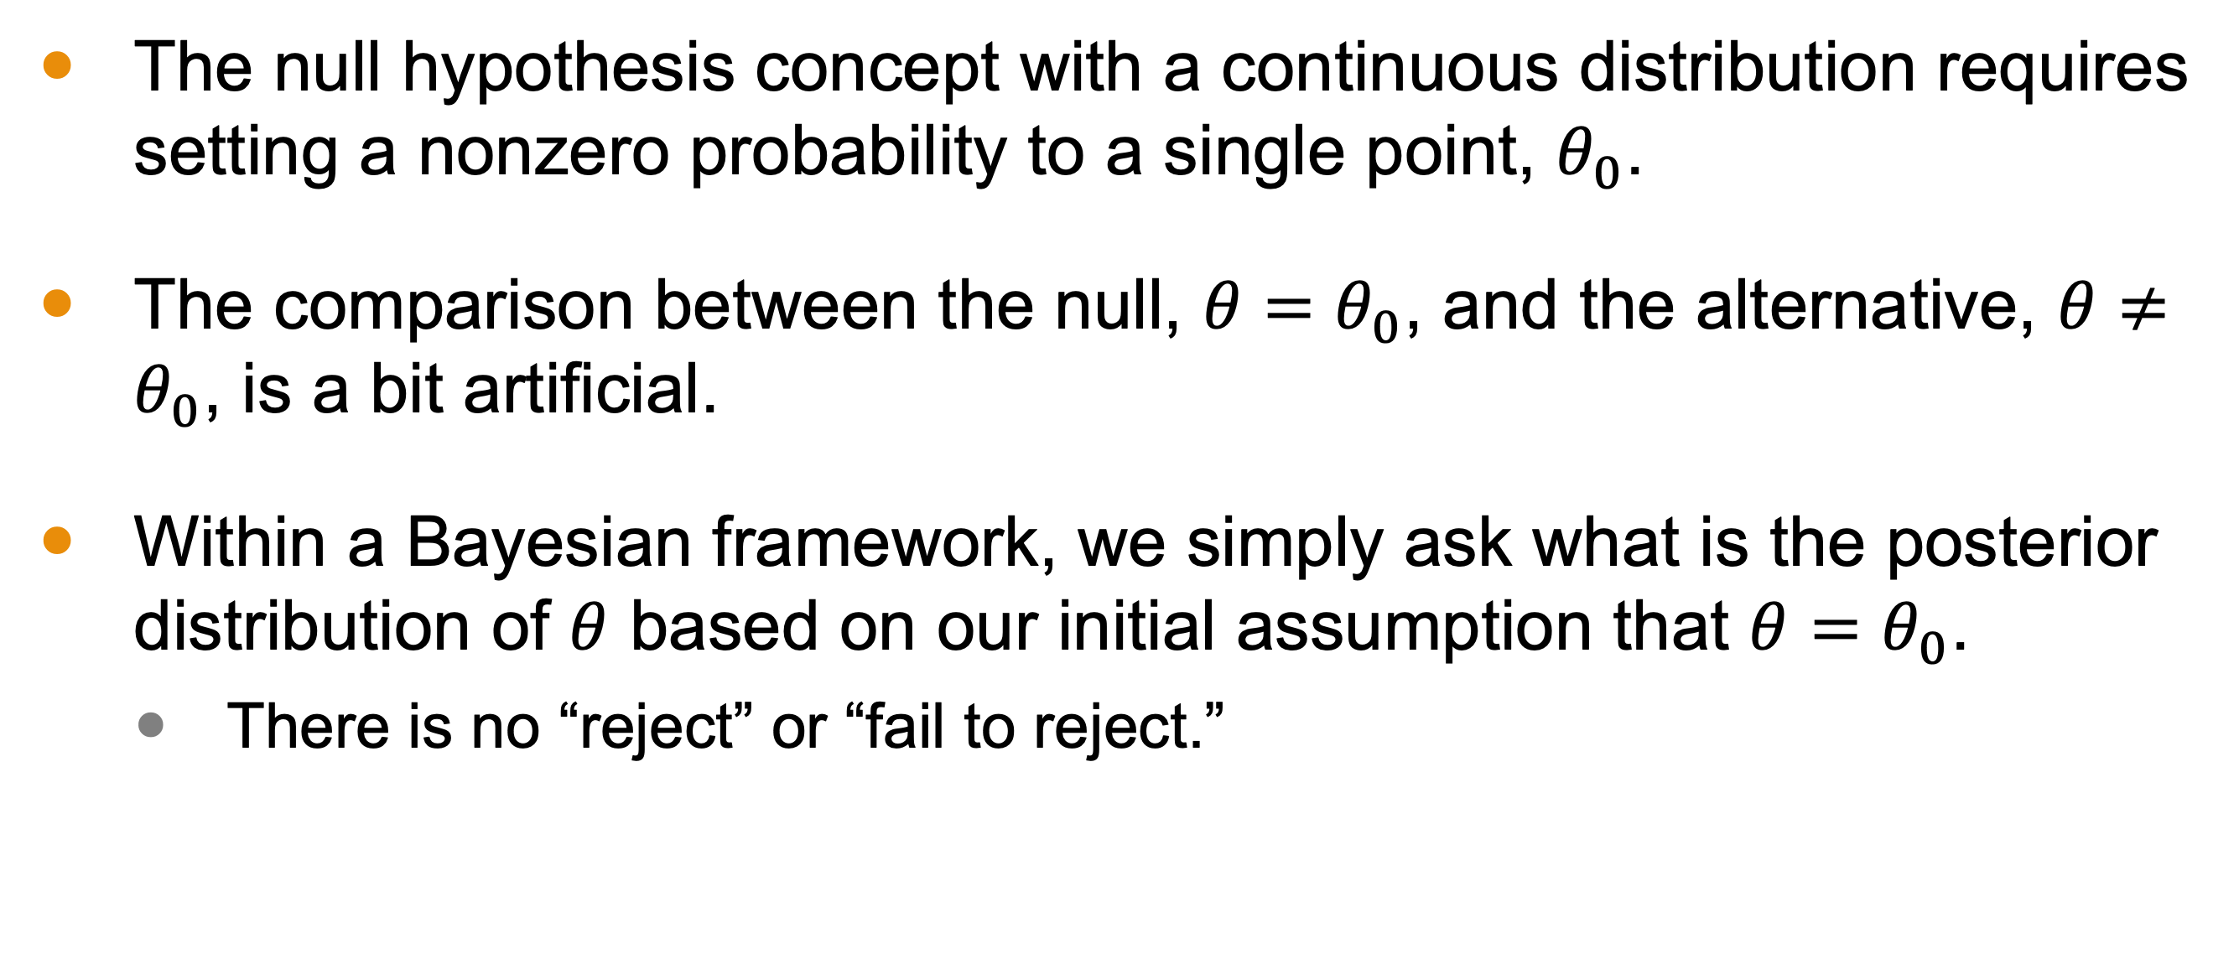
Hypothesis Testing
The null hypothesis concept with a continuous distribution requires setting a nonzero probability to a single point, $θ_{0}$.
The comparison between the null, $θ=θ_{0}$, and the alternative, $θ≠θ_{0}$, is a bit artificial.
Within a Bayesian framework, we simply ask what is the posterior distribution of $θ$ based on our initial assumption that $θ=θ_{0}$.
There is no “reject” or “fail to reject.”
Notes:
In various simple one-sided hypothesis tests, conventional p-values may correspond with posterior probabilities under noninformative prior distributions. For example, suppose we observe y = 1 from the model y ∼ N(θ, 1), with a uniform prior density on θ. One cannot ‘reject the hypothesis’ that θ = 0: the one-sided p-value is 0.16 and the two-sided p-value is 0.32, both greater than the conventionally accepted cutoff value of 0.05 for ‘statistical significance.’ On the other hand, the posterior probability that θ > 0 is 84%, which is a more satisfactory and informative conclusion than the dichotomous verdict ‘reject’ or ‘do not reject.’

Slide 13
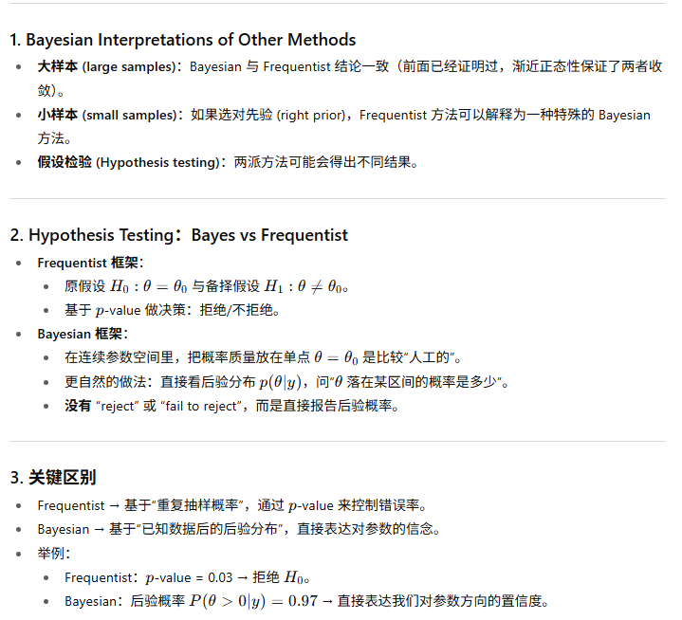
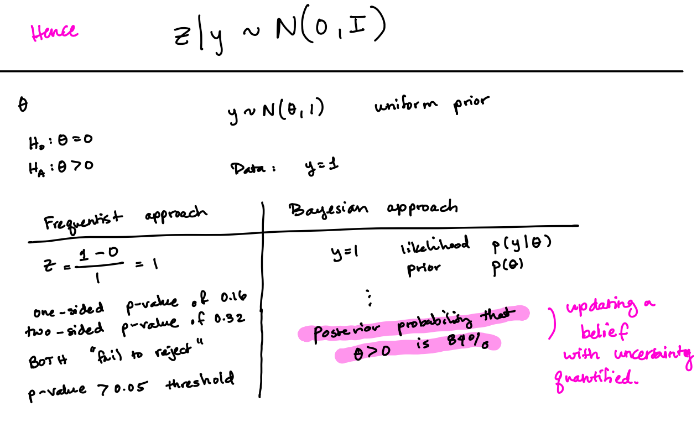
Notes:
Do the example

Slide 14
Challenges of Nonparametric Methods
Nonparametric methods, those that avoid complete probability models, cannot be easily evaluated using Bayesian methods.
Without a specified probability model, it is difficult to test the assumptions.
With such methods, however, there is often a Bayesian version that can be explored.
Here and in the reading, we see a Bayesian bootstrapping methodology

Slide 15
Bootstrapping
Bootstrapping is a technique often used in data science to estimate the prediction error for a given model.
Typically used when datasets are too small to allow for a testing set.
It involves sampling from dataset (with replacement) to create “bootstrapped” samples.
These samples are then used to estimate an unknown parameter, such as the expected prediction error.

Slide 16
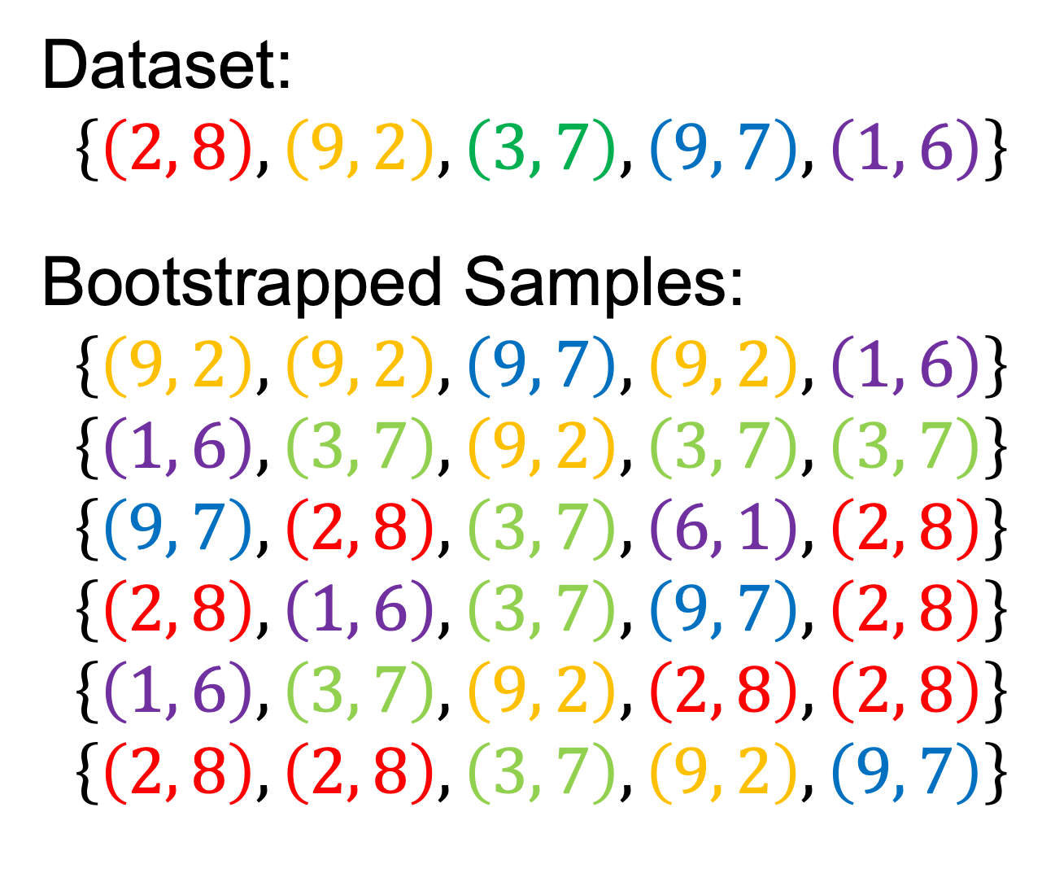
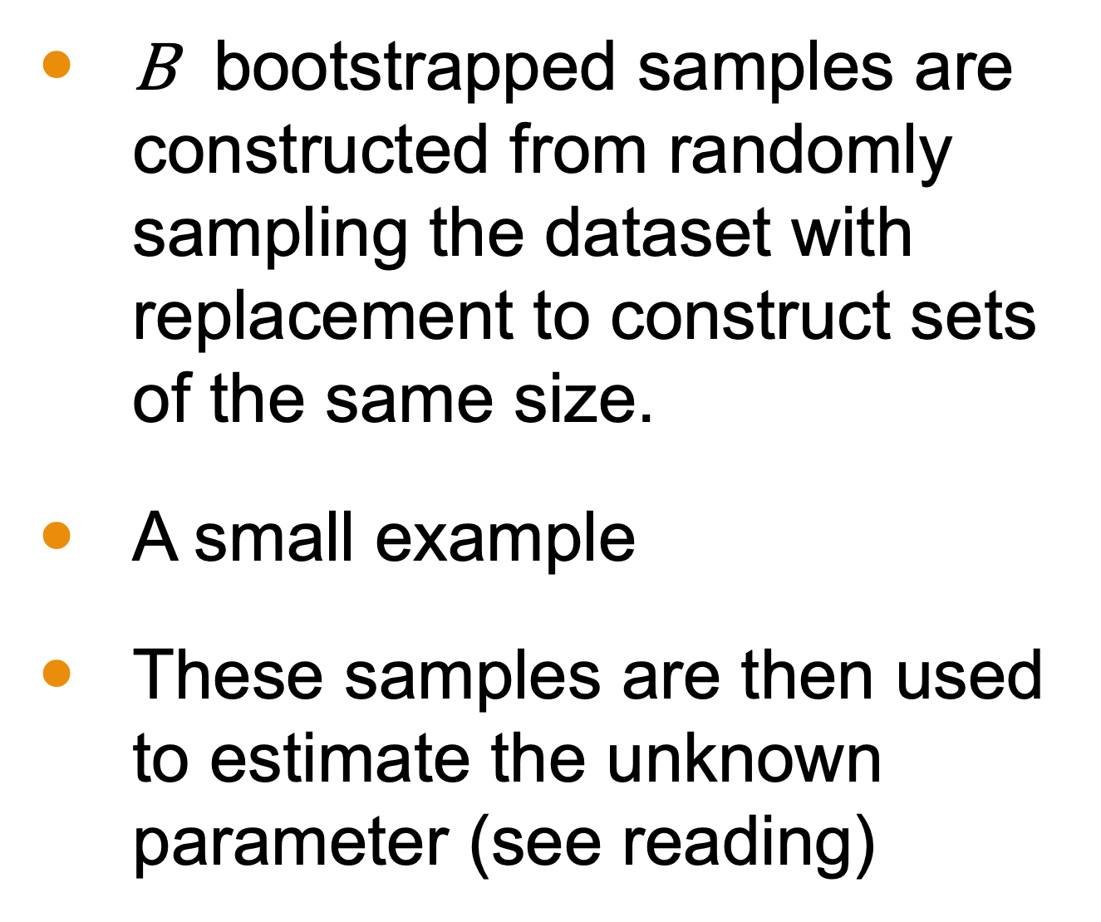
Bootstrapped Samples
$\text{B}$ bootstrapped samples are constructed from randomly sampling the dataset with replacement to construct sets of the same size.
A small example
These samples are then used to estimate the unknown parameter (see reading)
Dataset:
$$\left\{\left(2, 8\right), \left(9, 2\right), \left(3, 7\right), \left(9, 7\right), \left(1, 6\right)\right\}$$
Bootstrapped Samples:
$$\left\{\left(9, 2\right),\left(9, 2\right),\left(9, 7\right), \left(9, 2\right), \left(1, 6\right)\right\}$$
$$\left\{\left(1, 6\right),\left(3, 7\right),\left(9, 2\right),\left(3, 7\right),\left(3, 7\right)\right\}$$
$$\left\{\left(9, 7\right),\left(2, 8\right),\left(3, 7\right),\left(6, 1\right),\left(2, 8\right)\right\}$$
$$\left\{\left(2, 8\right),\left(1, 6\right),\left(3, 7\right),\left(9, 7\right),\left(2, 8\right)\right\}$$
$$\left\{\left(1, 6\right),\left(3, 7\right),\left(9, 2\right),\left(2, 8\right),\left(2, 8\right)\right\}$$
$$\left\{\left(2, 8\right),\left(2, 8\right),\left(3, 7\right),\left(9, 2\right),\left(9, 7\right)\right\}$$

Slide 17
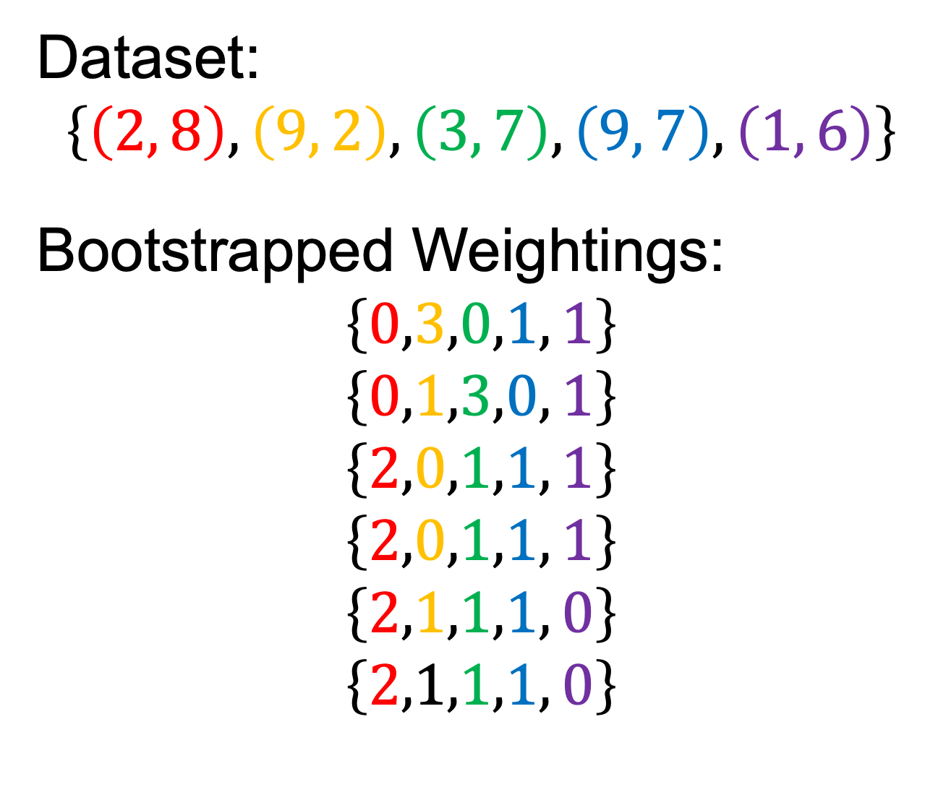
Bayesian Bootstrapping
Bayesian bootstrapped samples are seen as weightings of the data.
These new weightings of the dataset are used to compute the posterior distribution of the unknown parameter.
Dataset:
$$\left\{\left(2, 8\right), \left(9, 2\right), \left(3, 7\right), \left(9, 7\right), \left(1, 6\right)\right\}$$
Bootstrapped Weightings:
$$\left\{0,3,0,1, 1\right\}$$
$$\left\{0,1,3,0, 1\right\}$$
$$\left\{2,0,1,1, 1\right\}$$
$$\left\{2,0,1,1, 1\right\}$$
$$\left\{2,1,1,1, 0\right\}$$
$$\left\{2,1,1,1, 0\right\}$$

